Slide 1

“Railway Crack Detection using CNN”
Dayananda Sagar College of Engineering
Project phase 1 Presentation 7th Semester
Submitted by
Amrutha N Daivagna 1DS20EE008
Deeksha Purushotham 1DS20EE024
Devika S Kumar 1DS20EE026
Ishika Daga 1DS20EE028
Under the Guidance of
Dr. Sujit Kumar
Assistant Professor
Dept. EEE, DSCE

Slide 2
Table of content
Abstract
Objectives
Literature Survey
Problem Statement and Proposed System
Methodology
Block Diagram
Partial Output
Work to be carried out
Conclusion

Slide 3
Abstract
For better inspections and security, we need an efficient railway track crack detection system. In this research, we present a computer vision-based technique to detect the railway track cracks automatically. This system uses images captured by a rolling camera attached just below a self-moving vehicle in the railway department. The source images considered are the cracked and crack-free images. These extracted features are given as input to the deep learning neural network for differentiating the cracked track image from the non-cracked track image.

Slide 4
Objectives:
The main aim of project is to design a system which will detect the railway track crack faults, using Image Processing and Machine Learning.
Detecting and classifying healthy and cracked track.

Slide 5
Literature Survey:

Slide 6
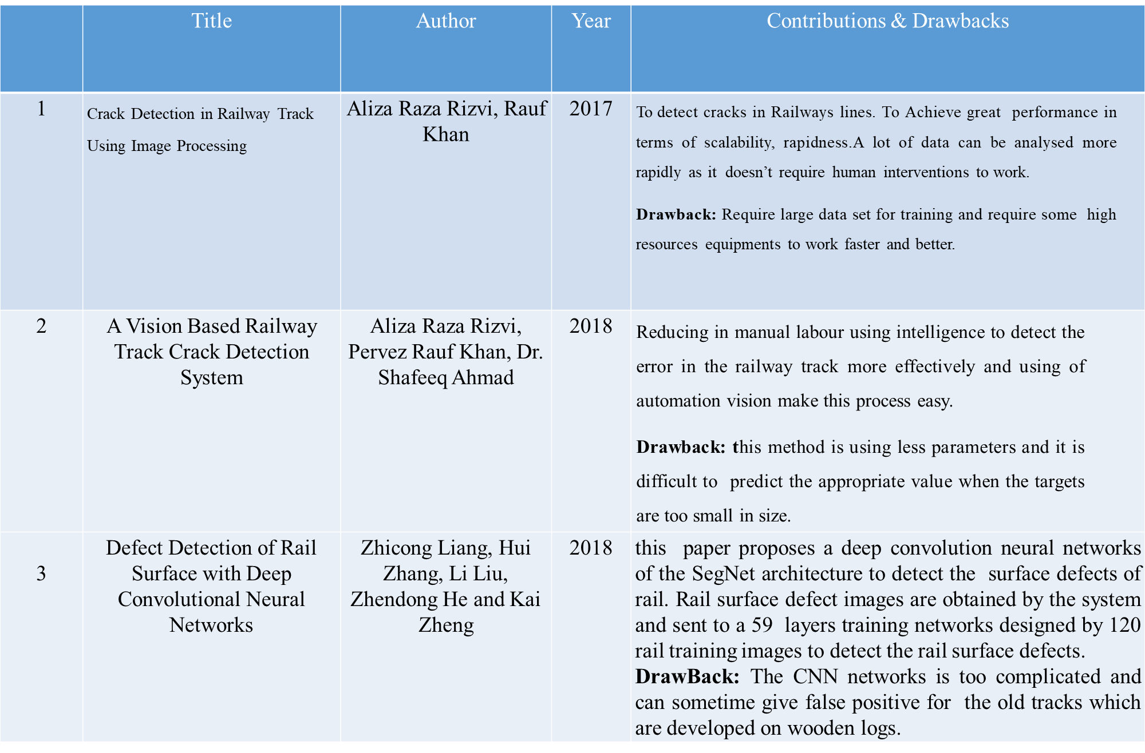

Slide 7
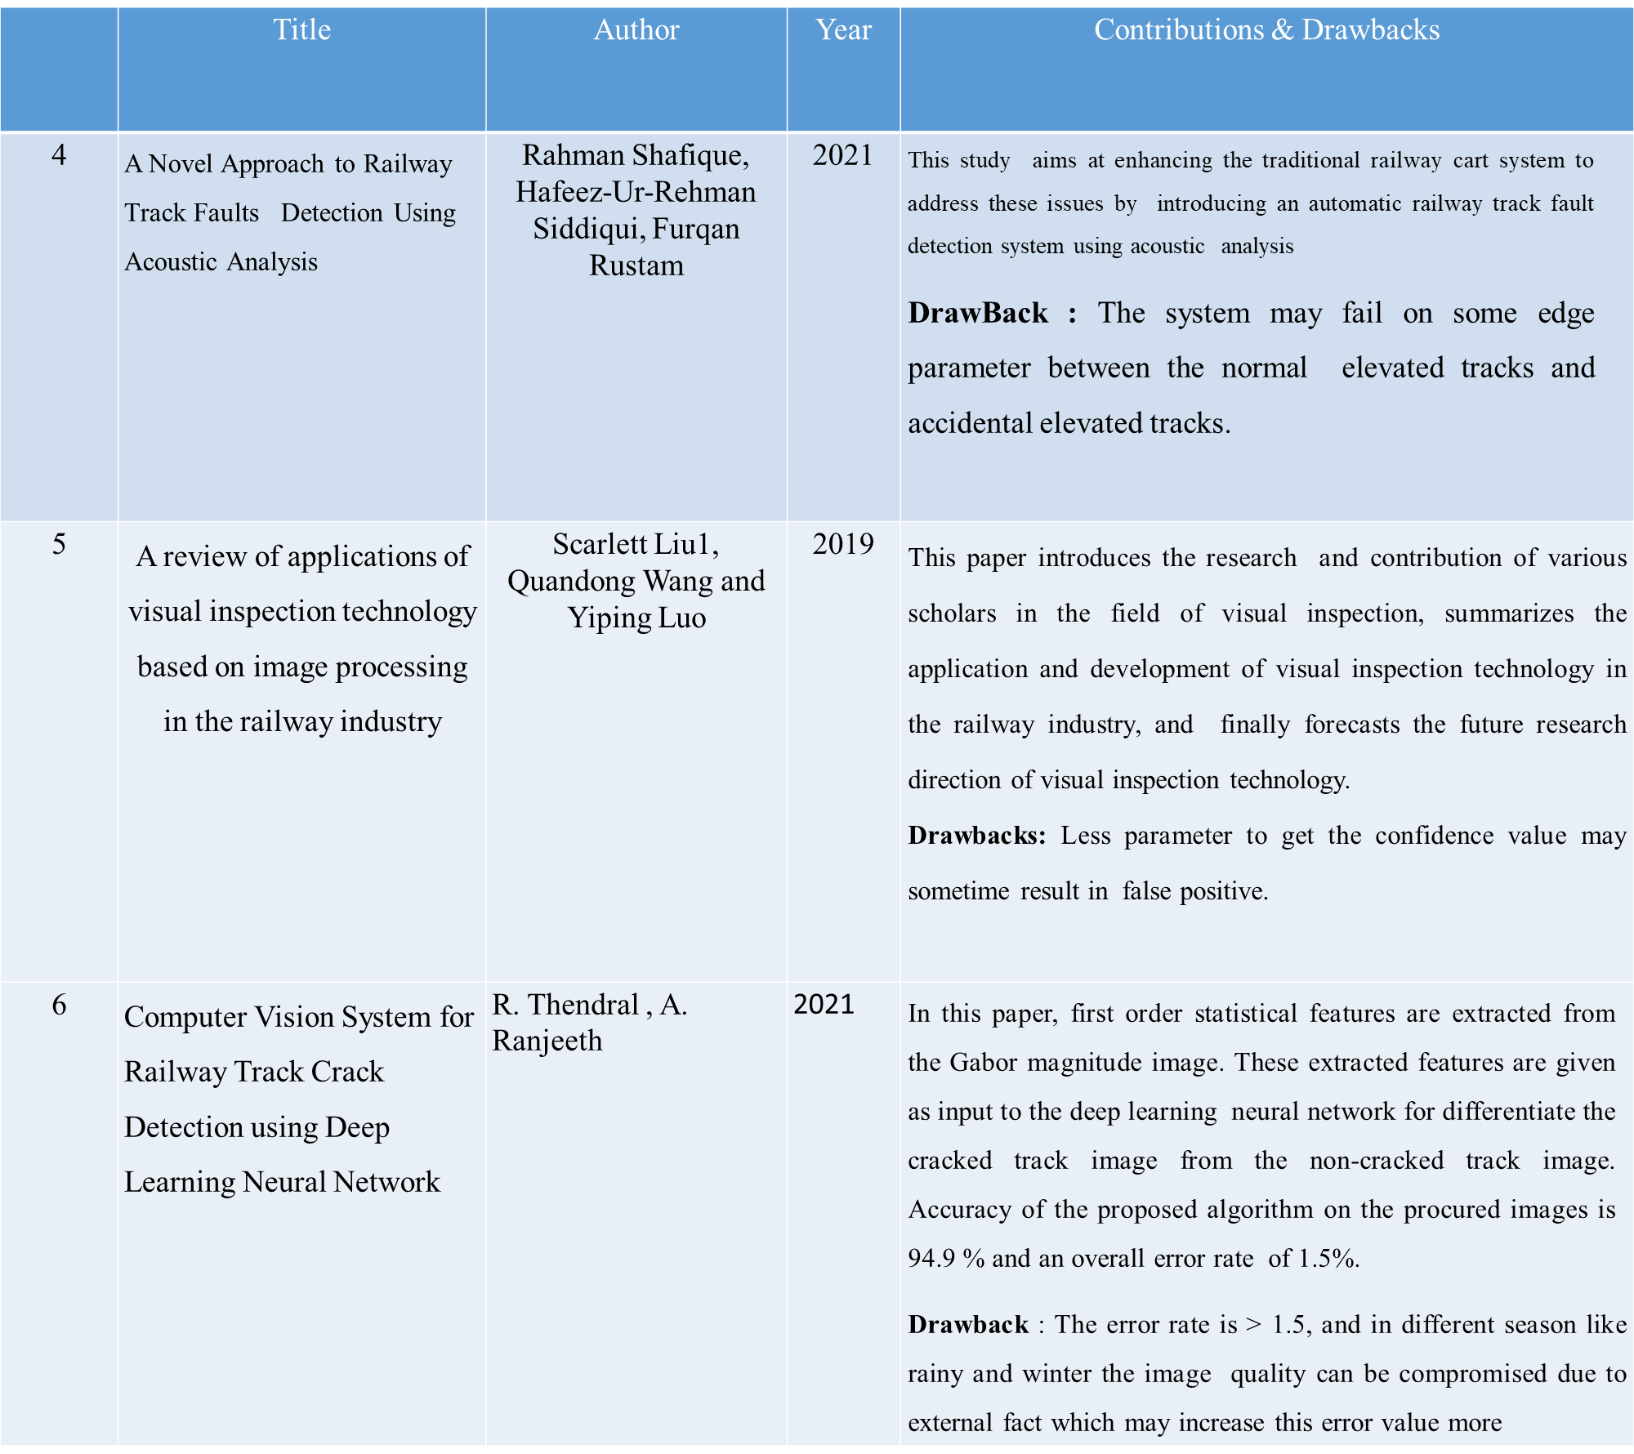

Slide 8
Problem Statement
To implement a deep learning model using CNN for crack detection on railway tracks.
Proposed System
The proposed framework focuses on implementing a Open CV python model to detect the railway track cracks through image processing and machine learning techniques.
Background subtraction is used to analyze the depth of the cracks. As an added advantage we also focus to create a separate model which will predict the cracks through machine learning techniques.
The simulated model provides good accuracy and prediction score.

Slide 9
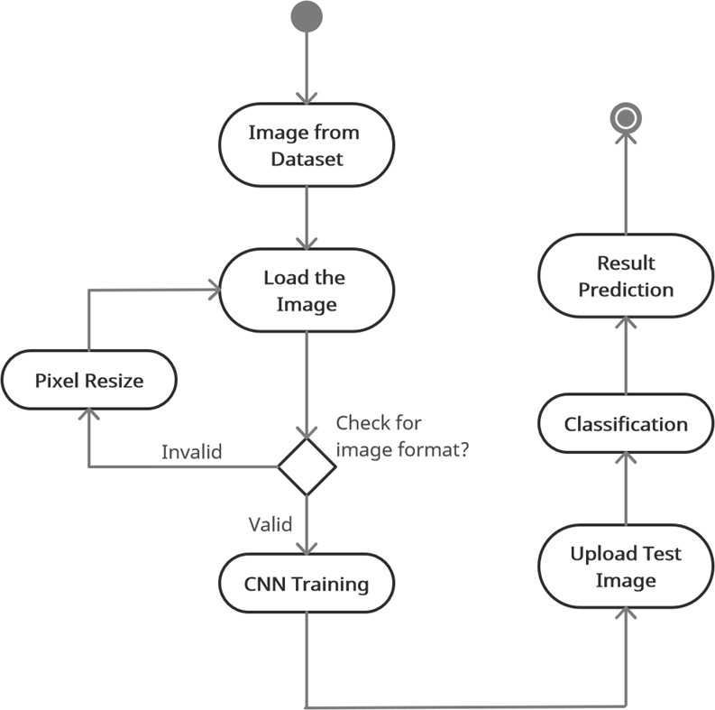
Methodology
Fig 1: Methodology; The process of capturing, acquiring and processing the image set

Slide 10
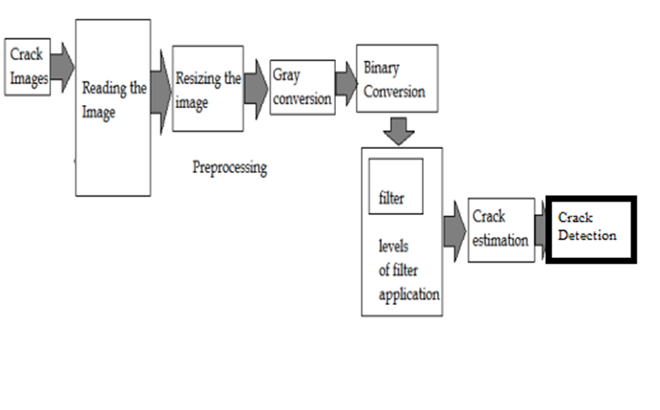
Block Diagram
Fig 3: Block Diagram

Slide 11
Software Requirement Specification
Functional Requirements:
The system should automatically detect the input image.
The system should automatically classify the input image.
The system should automatically detect cracks.
The system should automatically notify the concerned person.
Non-functional Requirements:
Usability: The system should have an easy interface for capturing images and alerting the concerned person in case of a crack.
Reliability: The system should reliably detect cracks. The system should reliably provide notifications.
Performance: The system should not take excessive time to detect cracks.
Supportability: The code should be easy to understand with provisions for future enhancements.

Slide 12
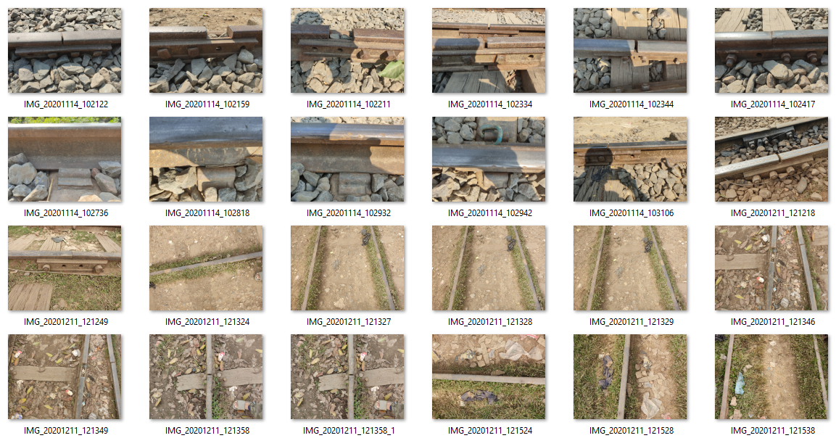
Sample Data Set
Fig 4: Data Set

Slide 13
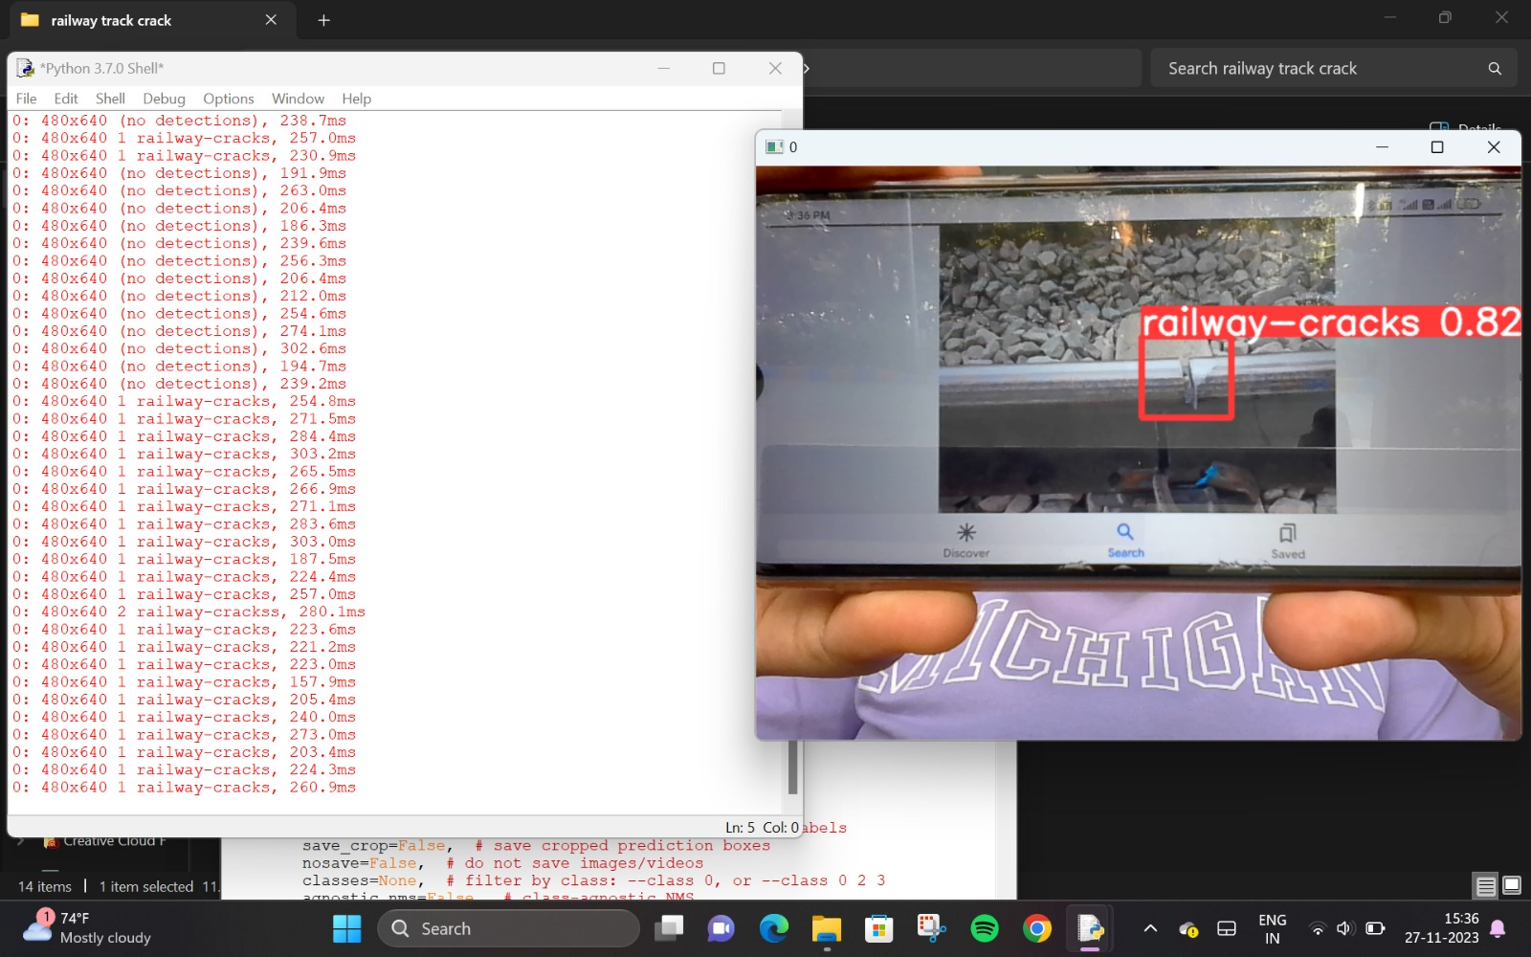
Partial Output
Fig 5: Partial Output

Slide 14
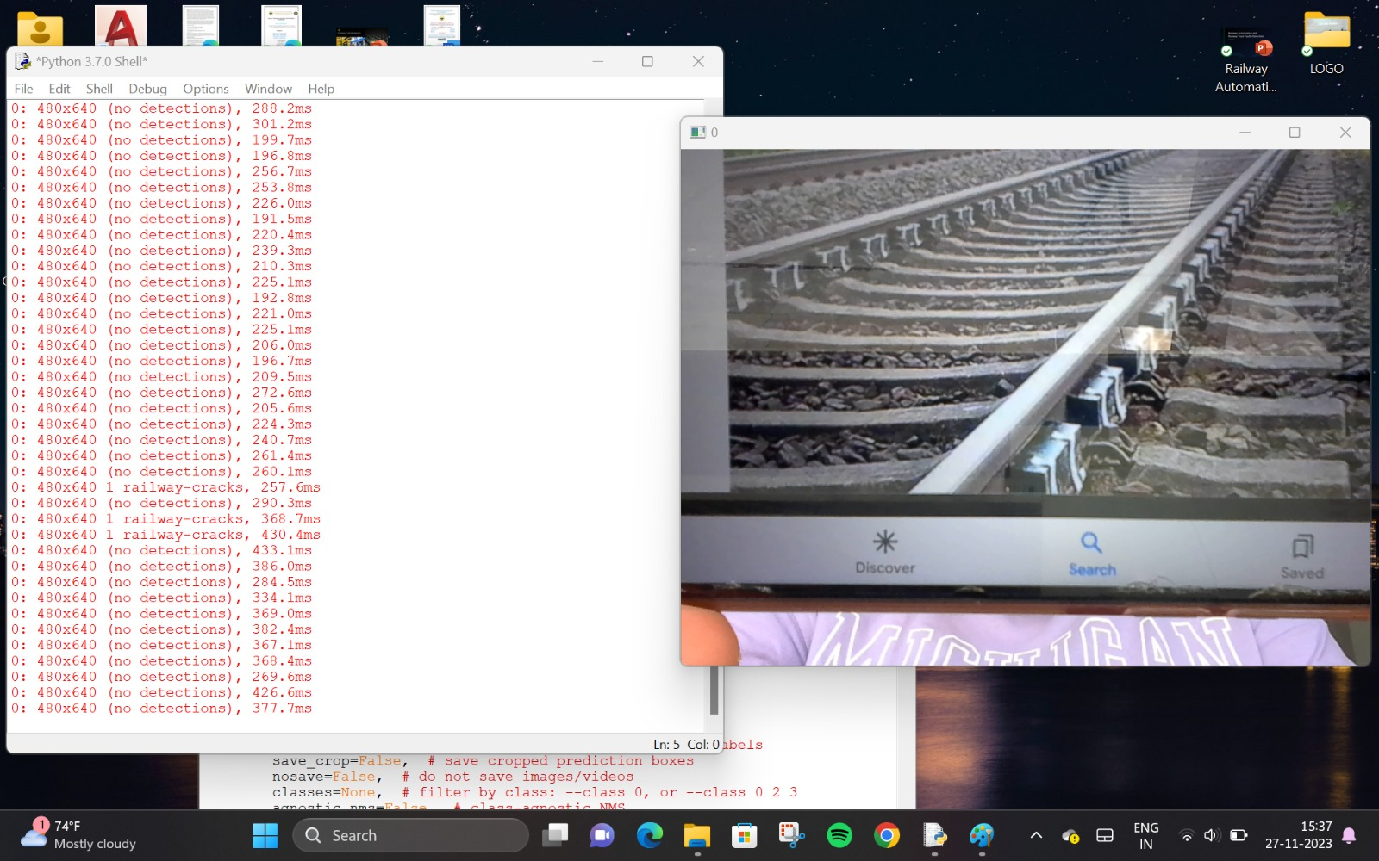
Fig 6: Partial Output

Slide 15
Work to be carried out
The software model has undergone training to learn patterns and features from a designated dataset.
During training, the model's parameters were adjusted to minimize errors and improve its ability to make accurate predictions.
Subsequent to training, the model was subjected to testing using new, unseen data to improve the accuracy.
The fabrication process of the trolley device is underway. The trolley device, once assembled, will rely on the microcontroller to execute commands and control its operations.
Software integration involves programming both the microcontroller and YOLO algorithm for specific tasks.
The software and the microcontroller along with the sensors would continuously detect the crack. Data from crack detection is stored for further analysis and processing.

Slide 16
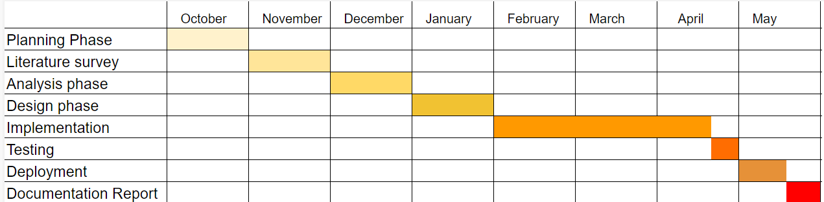
Fig 7: Remaining Work

Slide 17
Conclusion
In this project, a method to detect cracks in railway tracks has been presented using image processing techniques. The method replaces manual inspection of the track section, by automatic inspection. A video camera can be installed in separate sections of the track to take images of the track section and then it can be input to the suggested system to detect any cracks in the track section. This will help to detect cracks immediately and reduce the possibilities of any mishappening. Since the system would be automatic and will require less manual intervention, the utmost efficiency of the system can be ensured.

Slide 18
References
[1] Aalhad Welankiwar, Shubham Sherekar, Amol P Bhagat, Priti A Khodke “Fault Detection in Railway Tracks using Artificial Neural Networks”.
[2] S. Ntalampiras, “Fault identification in distributed sensor networks based on universal probabilistic modeling,” IEEE Trans. Neural Netw. Learn. Syst., vol. 26, no. 9, pp. 1939–1949, Sep. 2015.
[3] J. Chen, C. Roberts, and P. Weston, “Fault detection and diagnosis for railway track circuits using neuro-fuzzy systems,” Control Eng. Pract., vol. 16, no. 5, pp. 585–596, 2008.
[4] Johnny Asber (2020), A Machine Learning-Based Approach for Fault Detection of Railway Track and its Components
[5] Yash Goyal, Tejas Khot, Douglas Summers-Stay, Dhruv Batra, and Devi Parikh. Making the v invqa matter: Elevating the role of image understanding in visual question answering. In Proceedings of the IEEE Conference on Computer Vision and Pattern Recognition, pages 6904–6913, 2017.

Slide 19
[6] Ranjay Krishna, Yuke Zhu, Oliver Groth, Justin Johnson, Kenji Hata, Joshua Kravitz,
Stephanie Chen, Yannis Kalantidis, Li-Jia Li, David A Shamma, et al. Visual genome
[7] Yash Srivastava, Vaishnav Murali, Shiv Ram Dubey, and Snehasis Mukherjee. Visual question answering using deep learning: A survey and performance analysis. arXiv preprint arXiv:1909.01860, 2019.
[8] Jiasen Lu, Jianwei Yang, Dhruv Batra, and Devi Parikh. Hierarchical question-image co- attention for visual question answering. In Advances in neural information processing systems, pages 289–297, 2016.

Slide 20
THANK YOU!

